Slide 1
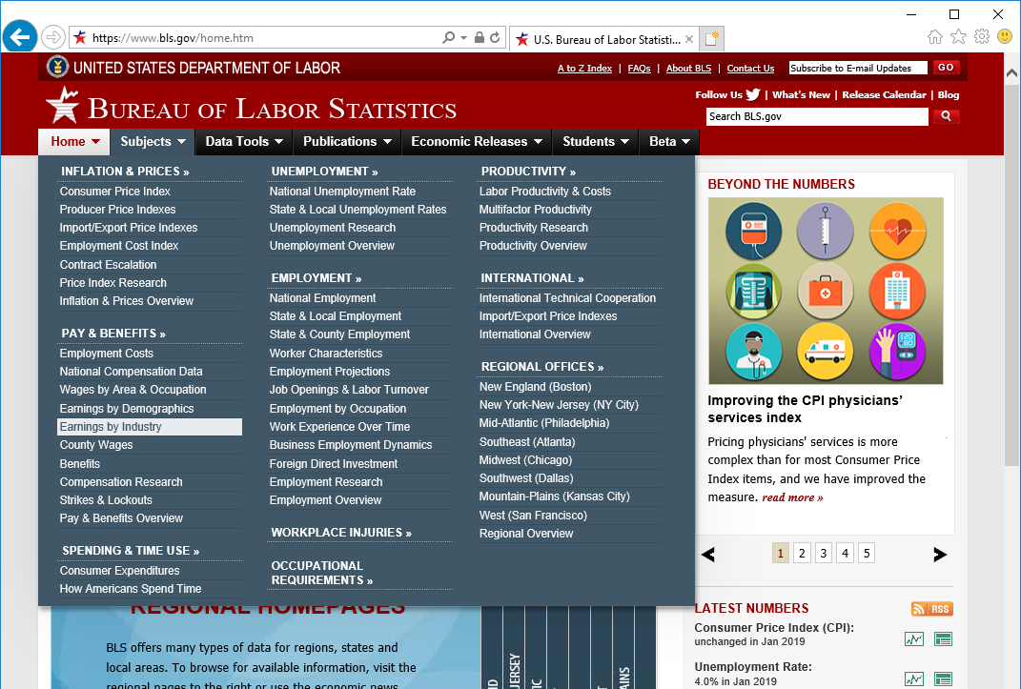
Procedure to obtain Labor Cost Index data for USA
Go to :
Move your cursor to “Subjects” and select “Earning by industry”
bls.gov

Slide 2
Procedure to obtain Labor Cost Index data for USA
Click on CES Data
Click on Databases

Slide 3
Procedure to obtain Labor Cost Index data for USA
Under CES National Databases, select Multi Screen

Slide 4
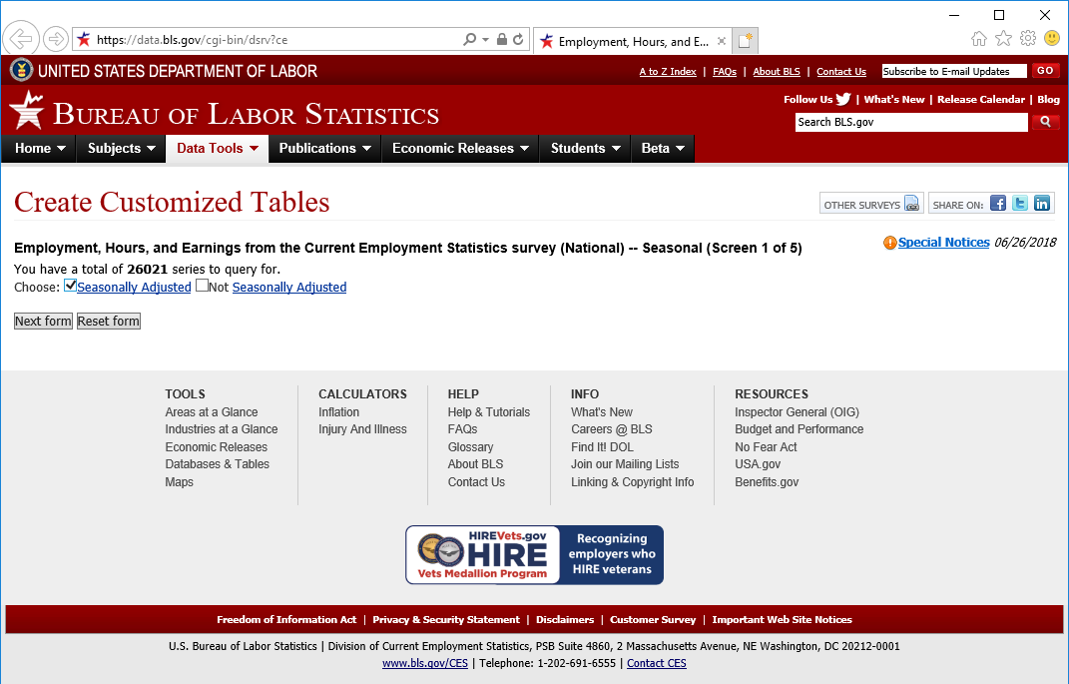
Procedure to obtain Labor Cost Index data for USA
Choose “Seasonally Adjusted”
Click on “Next form”

Slide 5
Procedure to obtain Labor Cost Index data for USA
Example 1: Production worker wages in a manufacturing industry

Slide 6
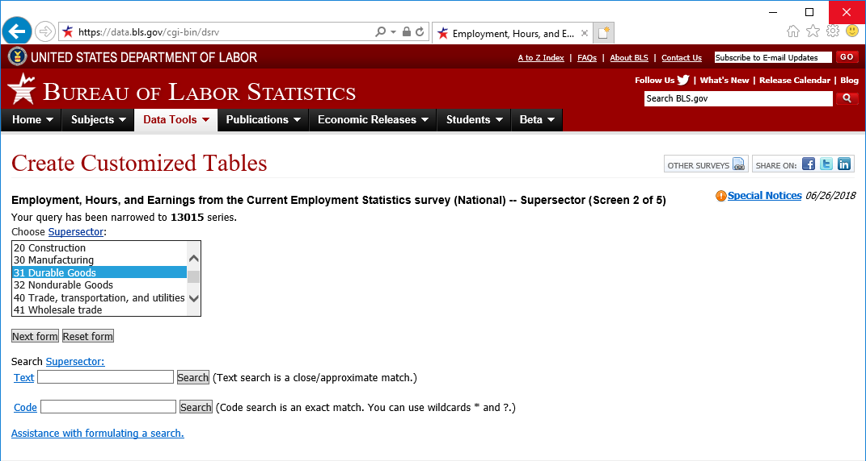
Procedure to obtain Labor Cost Index data for USA
Select “31 Durable Goods”
Click on “Next form”

Slide 7
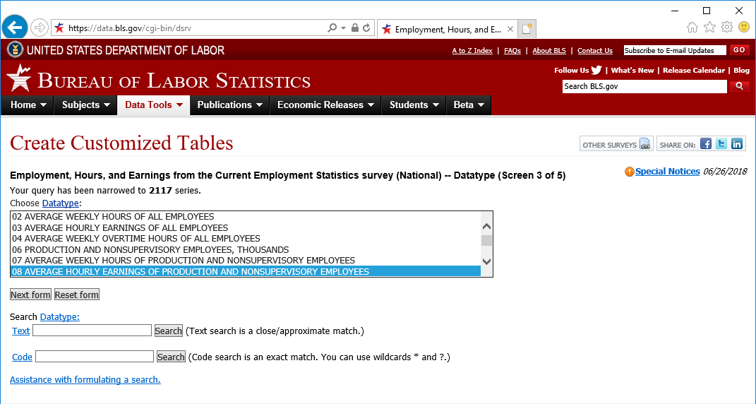
Procedure to obtain Labor Cost Index data for USA
Select “08 Average hourly earnings of production and nonsupervisory employees”
Click on “Next form”

Slide 8
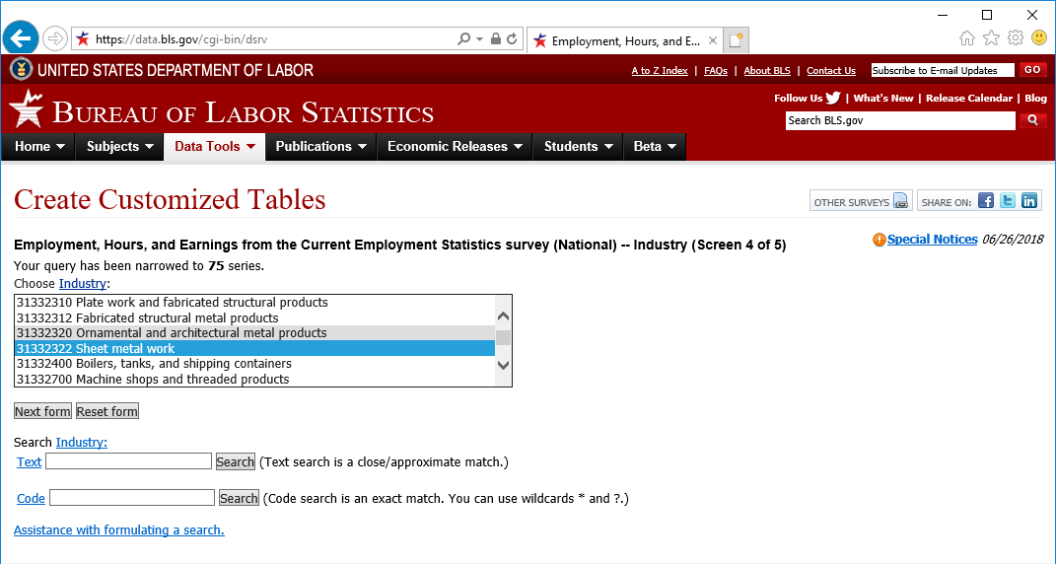
Procedure to obtain Labor Cost Index data for USA
Select the industry of interest. For example “31332322 Sheet metal work”.
Note: the last 6 digits refer to the NAICS code of the industry
Click on “Next form”

Slide 9
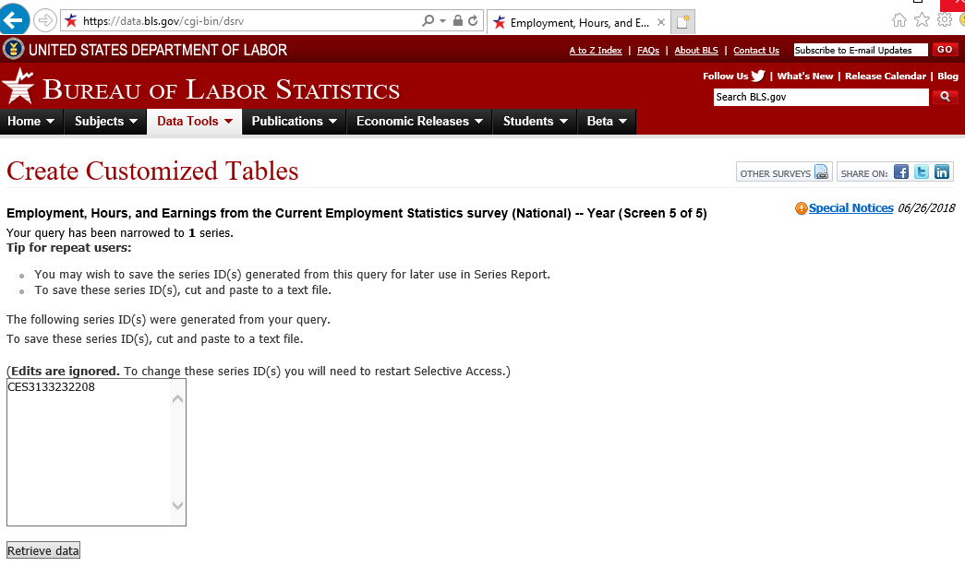
Procedure to obtain Labor Cost Index data for USA
Click on “Retrieve data”

Slide 10
Procedure to obtain Labor Cost Index data for USA
The monthly average hourly earnings values are displayed in a table
Data can be downloaded in excel format by clicking “xlsx”

Slide 11
Procedure to obtain Labor Cost Index data for USA
Example 2: Worker wages in a service industry

Slide 12
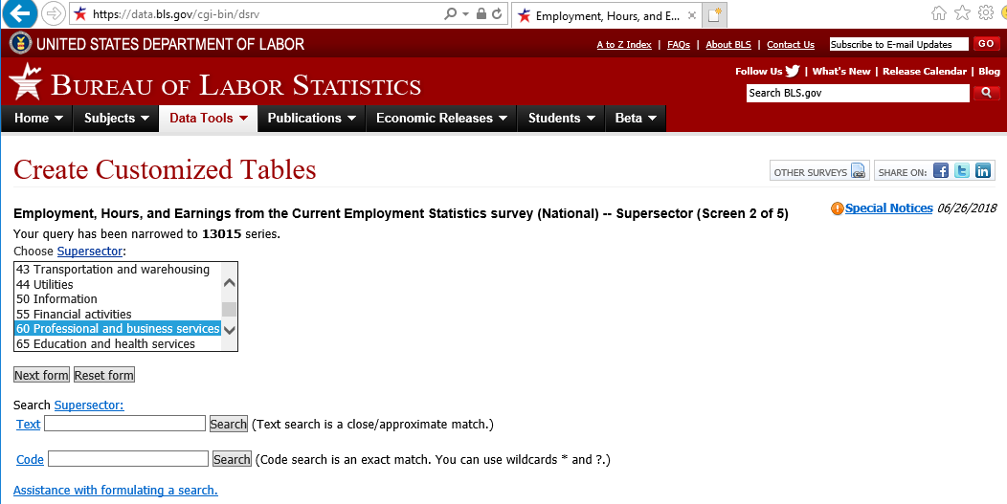
Procedure to obtain Labor Cost Index data for USA
Select “60 Professional and business services”
(or “43 Transportation and warehousing” for logistics-type services)
Click on “Next form”

Slide 13
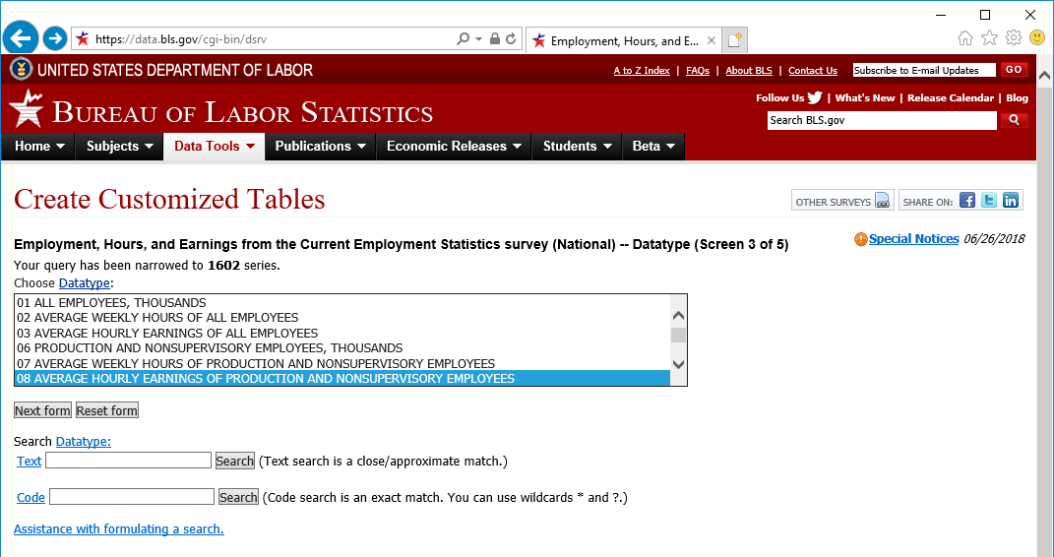
Procedure to obtain Labor Cost Index data for USA
Select “08 Average hourly earnings of production and nonsupervisory employees”
Click on “Next form”

Slide 14
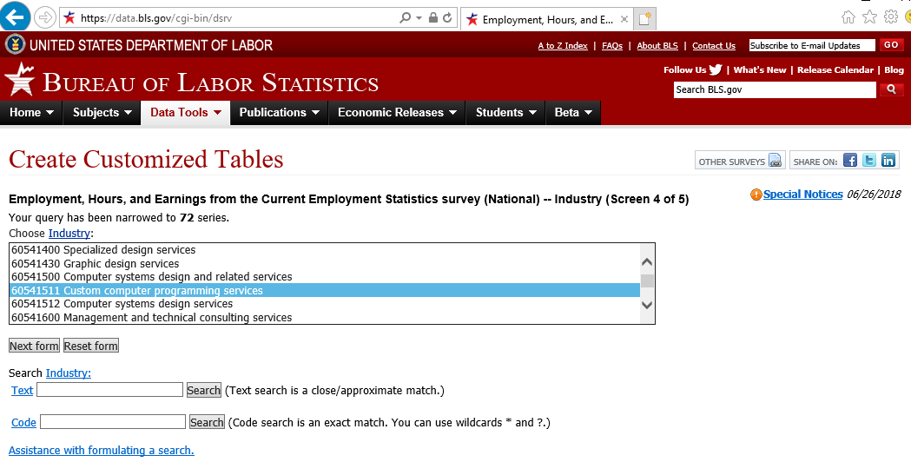
Procedure to obtain Labor Cost Index data for USA
Select the industry of interest. For example “Custom computer programming services”.
Note: the last 6 digits refer to the NAICS code of the industry
Click on “Next form”

Slide 15
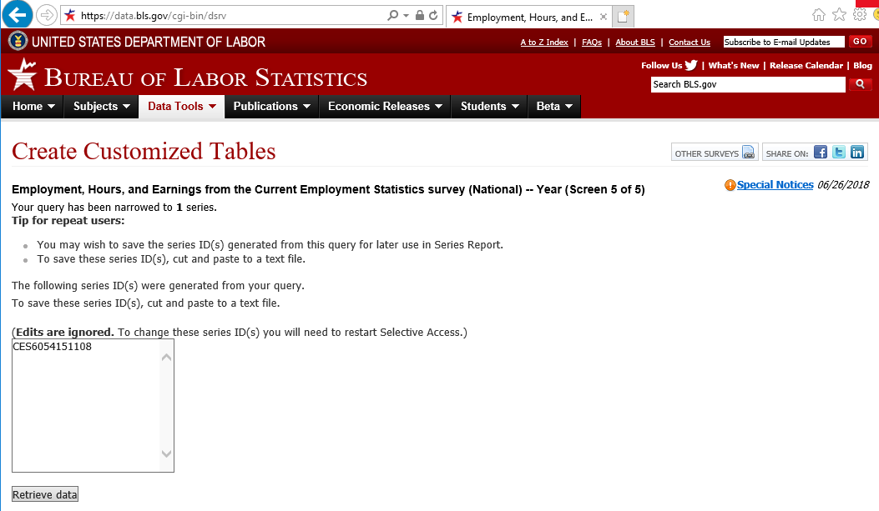
Procedure to obtain Labor Cost Index data for USA
Click on “Retrieve data”

Slide 16
Procedure to obtain Labor Cost Index data for USA
The monthly average hourly earnings values are displayed in a table
Data can be downloaded in excel format by clicking “xlsx”

